Slide 1

Brain Tumor Detection using CNN
BATCH: A12
Aayush Karan Shrivastav – 19P71A0503
Piyush karan – 19P71A0528
Dhanya pendyala - 19P71A0531
Internal guide: mrs. sridevi ma’am

Slide 2
Abstract
Data processing and learning have become a spearhead for the advancement of medicine, with pathology and laboratory medicine as no exception. The incorporation of scientific research through clinical informatics, including genomics,
proteomics, bioinformatics, and biostatistics, into clinical practice, unlocks innovative approaches to patient care. The rise of Artiﬁcial Intelligence (AI) and Deep Learning (DL) techniques and their applications in various ﬁelds have brought immense value in providing insights into advancement in support of medical pathology. In this project, Deep Learning models are proposed for classifying these pathologies, including Convolutional neural networks (CNN). To test and improve the CNN model accuracy Transfer Learning (TL) is used. The analysis is done by training, validating, and testing data. Depending upon the analysis of data by applying the CNN algorithm pathosis is measured. Deep Learning, unlocked through information integration and advanced digital communication networks, has the potential to improve clinical workflow efficiency, and diagnostic quality, and ultimately create personalized diagnoses and treatment plans for patients. This review describes clinical perspectives and discusses the statistical methods, clinical applications, potential obstacles, and future directions of medical pathology using AI and DL.

Slide 3
Introduction
Brain tumor is one of the most rigorous diseases in medical science
An effective and efficient analysis is always a key concern for the radiologist in the premature phase of tumor growth.
Histological grading, based on a stereotactic biopsy test, is the gold standard and the convention for detecting the grade of a brain tumor.
The biopsy procedure requires the neurosurgeon to drill a small hole into the skull from which the tissue is collected.

Slide 4
Existing System:
At the first stage, this method includes some noise removal functions improving features that provide better characteristics of medical images for reliable diagnosis using the Balance Contrast Enhancement Technique (BCET).
The result of the second stage is subjected to image segmentation using the Fuzzy c-Means (FCM) clustering method.
Finally, the Canny edge detection method is applied to detect the fine edges. During the experimental study, we used images containing brain tumors that were characterized by a different location, type of pathology, shape, size, and density, as well as the size of the area of the affected tissue near the tumor space.
Detection and extraction of tumors from MRI scan images of the brain are done using MATLAB software. The obtained results demonstrate some resistance to noise. Also, the accuracy of segmentation, in some cases of tumor pathology.
Disadvantages in Existing System:
By using the fuzzy c-means (FCM) algorithm the accuracy is 80%
And the number of iterations is also less.
But FCM is highly vulnerable to noise due to not considering the spatial information in image segmentation.

Slide 5
Proposed System:
Here we are going to detect the tumor using a human-trained model we trained our model using images and we got an accuracy of nearly >90% using the CNN algorithm.
And the person can collect their MRI and then upload a copy of an image to our webpage then from there he can get to know whether he is detected with a brain tumor or not.
And then from there, he can proceed for further treatment.

Slide 6
Advantages of the Proposed System:
Our system aims to eliminate the necessity of performing biopsy or surgery to identify whether the image shows any malignancy or not.
It is considered the best ml technique for image classification due to its high accuracy.
Image pre-processing required is much less compared to other algorithms.
It is used over feed-forward neural networks as it can be trained better in case of complex images to have higher accuracies.
It reduces images to a form that is easier to process without losing features that are critical for a good prediction by applying relevant filters and reusability of weights
It can automatically learn to perform any task just by going through the training data i.e. there is no need for prior knowledge
There is no need for specialized hand-crafted image features like that in the case of SVM, Random Forest, etc…

Slide 7
Convolutional Neural Networks:
There are 3 layers in CNN
Convolutional Layer – This is the first step in the process of extracting valuable features from an image. A convolution layer has several filters that perform the convolution operation. Every image is considered a matrix of pixel values.
Pooling Layer- Pooling is a down-sampling operation that reduces the dimensionality of the feature map. The rectified feature map goes through a pooling layer to generate a feature map. ReLU activation.
Fully Connected layer – The fully connected layer is a layer in which the input from the other layers will be flattened into a vector and sent. It will transform the output into the desired number of classes by the network.

Slide 8
Algorithm used:
Step 1:- First, we will pre-process the training set and then will pre-process the test set.
Step 2:- In the second part, we will build the whole architecture of CNN. We will initialize the CNN as a sequence of layers, and then we will add the convolution layer followed by adding the max-pooling layer.
Step 3:- Next, we will proceed to the flattening layer to flatten the result of all the convolutions and pooling into a one-dimensional vector, which will become the input of a fully connected neural network.
Step 4:- Finally, we will connect all this to the output layer.

Slide 9
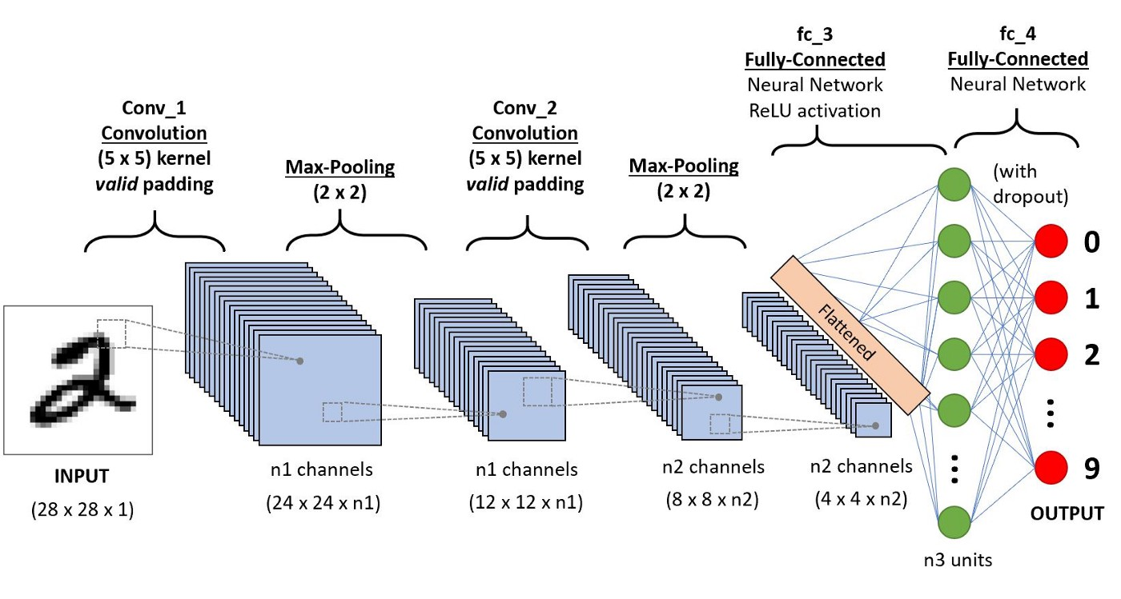

Slide 10
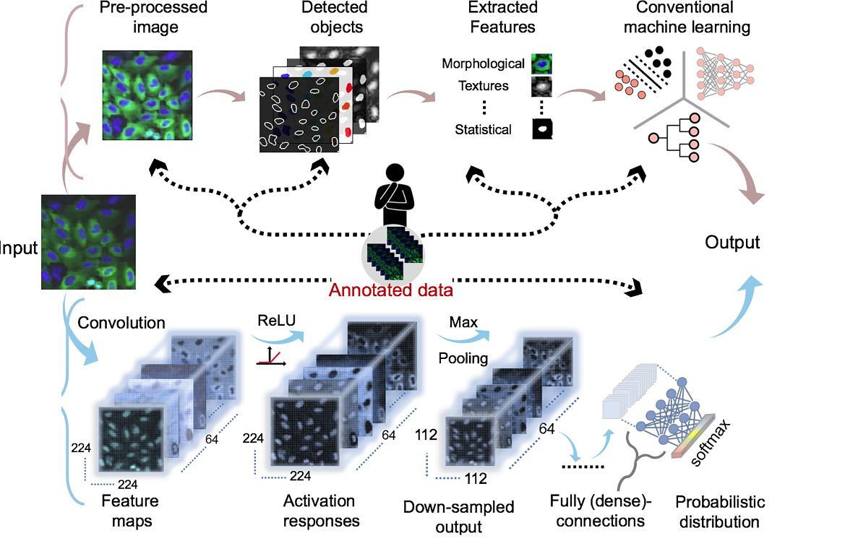
Architecture Diagram:

Slide 11
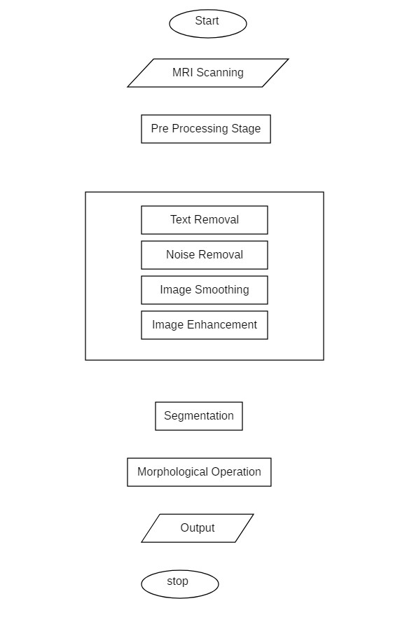
Block diagram :
Flow chart :
Datacollection
Image pre-processing
Segementation via binary thresholding
Feature extraction
Machine learning training
Model construction
Analysis and Conclusion
Tumor detection and classification
Validations on unknown test sampels

Slide 12

Modules in the System:
3 Modules:
1. Preprocessing of data
2. Training the model using CNN
3. Front-end design

Slide 13
Module 1 Description: Preprocessing the data
The first step is to collect the data.
Then we segregate the acquired data into training data and testing data.
We’re going to use the 10-fold clustering method to segregate the same using K-Means.
After that, The training data is allocated at 80%.
The test data is the remaining 20%.

Slide 14
Module 2: Training the model using CNN
In this module we train our model which is built using the CNN algorithm given the data which we have pre-processed.
Firstly we import the pre-processed data into our CNN algorithm i.e to the Convolutional Layer – In which the process of extracting valuable features from an image is done and then the convolution layer has several filters that perform the convolution operation. Every image is considered a matrix of pixel values.
The output of the Convolutional Layer will be the input of our second layer i.e Pooling Layer- here Pooling is a down-sampling operation that reduces the dimensionality of the feature map. The rectified feature map goes through a pooling layer to generate a feature map. We have used the ReLU activation function.
Here the output of the pooling layer will be the input of our third layer i.e Fully Connected layer – In this layer, the input from the other layers will be flattened into a vector and sent. It will transform the output into the desired number of classes by the network.
Once the model is trained with the data we do the epoch multiple times so that our model learns every time we train it through a concept called transfer learning.

Slide 15
Module 3: Front-end design
As part of module 3, we're going to create a webpage to display the output by taking input from the user.
On our web page the users are provided with an option to upload the MIR report as input.
Through which our model processes it and displays the result i.e the output will be shown if the brain tumor is detected or not in a flash.

Slide 16
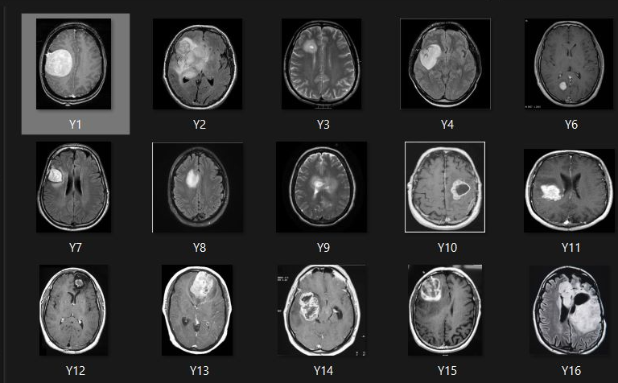
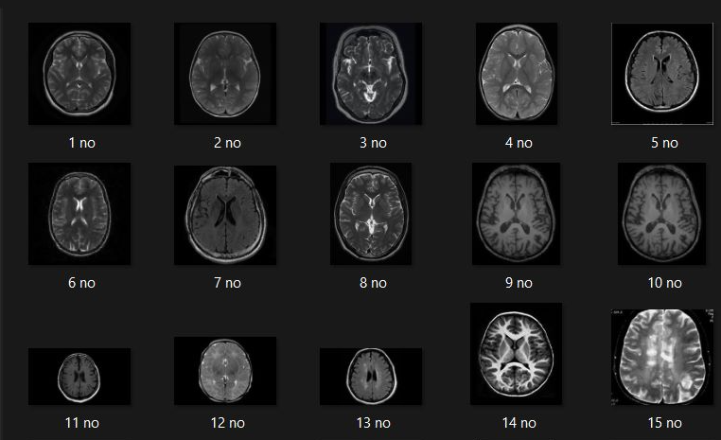
Output of Module - 1 :

Slide 17
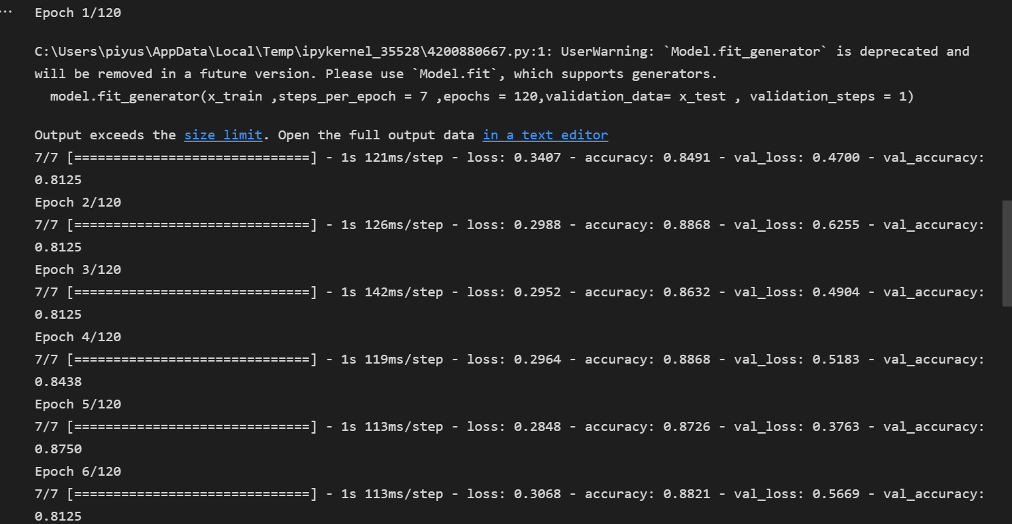
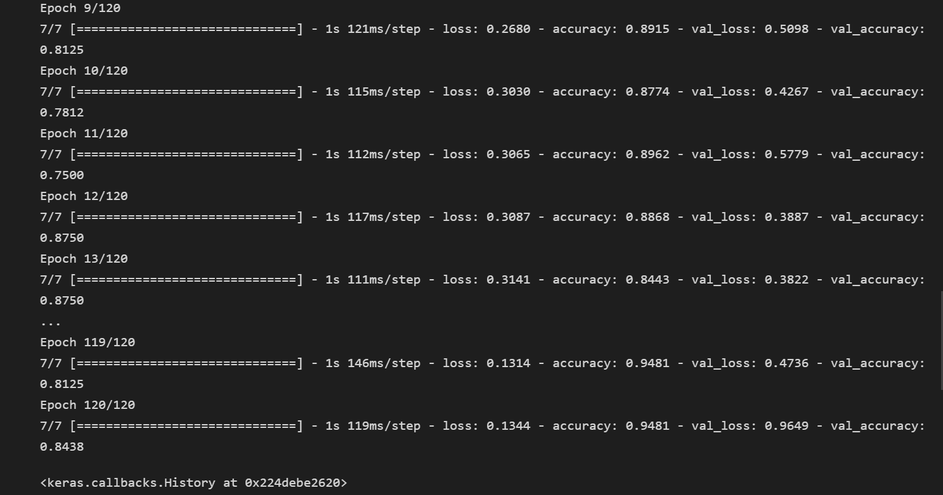
Output of Module - 2 :

Slide 18
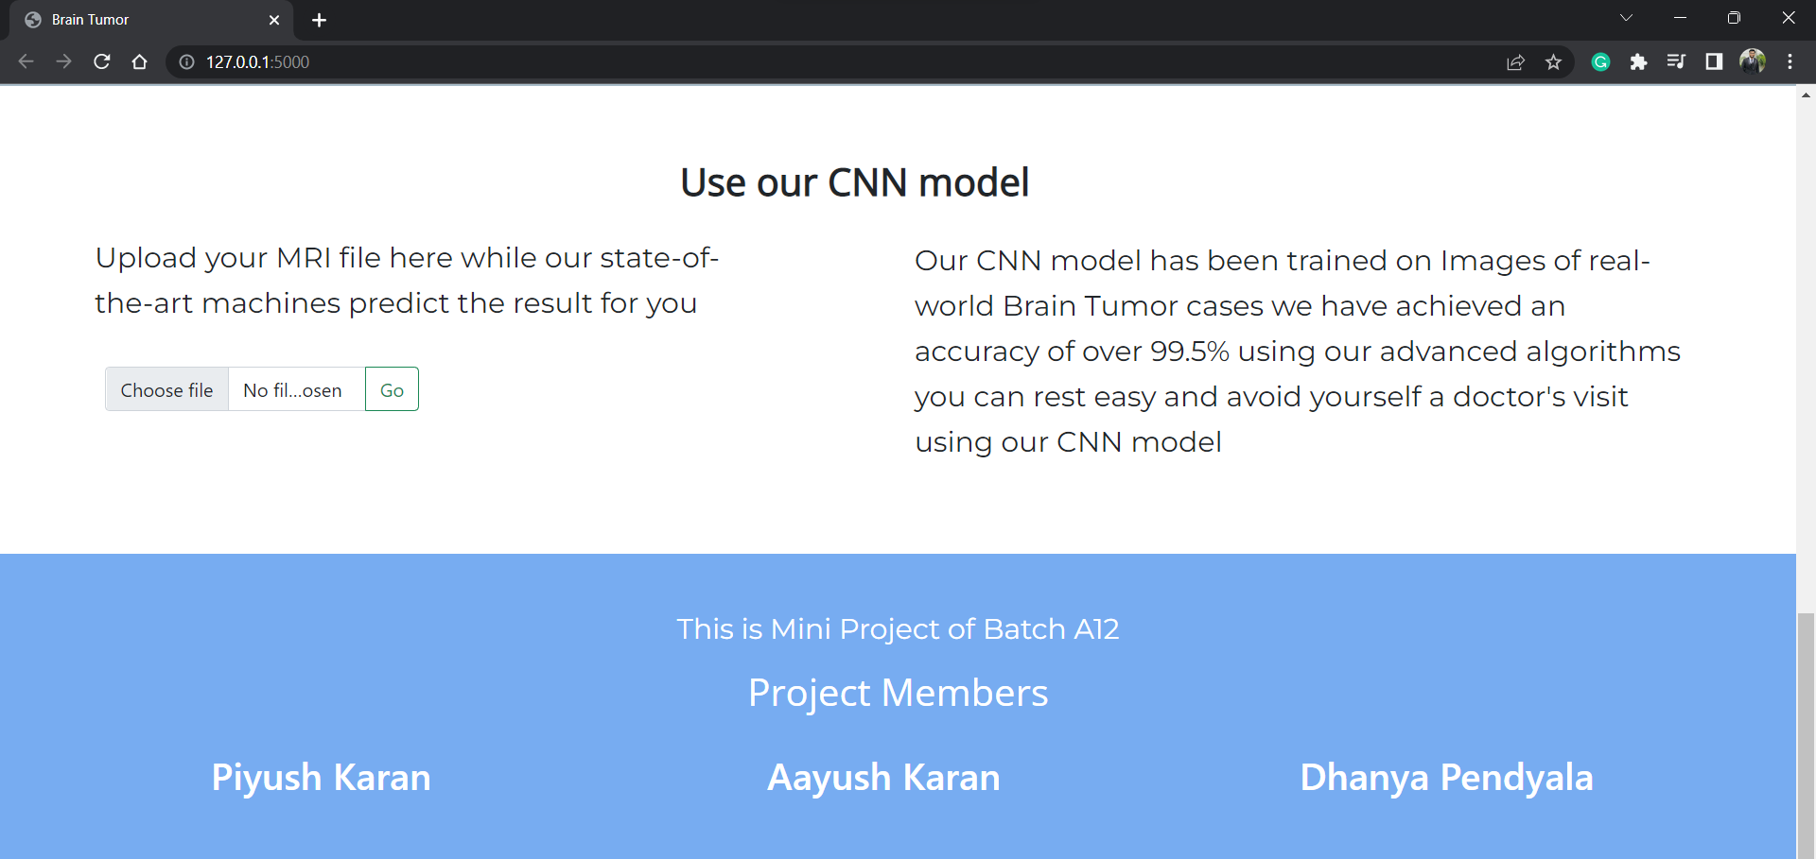
Output of Module - 3 :

Slide 19
Hardware and Software requirements:
Software:
Python 3 - We have used Python which is a statistical mathematical programming language. It is an open source and also provides more graphic packages and data sets Keras (with TensorFlow backend 2.3.0 version) - Keras is a neural network API consisting of TensorFlow,
Python packages like Numpy,
Pandas for mathematical computation and plotting graphs,
SimpleITK for reading the images which were in .mha format
Google Colab - open-source Jupyter Notebook, VS Code

Slide 20
Hardware and Software requirements:
Hardware:
Processor: Intel® Core™ i5-2350M CPU @ 2.30GHz
Installed memory (RAM):8.00GB
System Type: 64-bit Operating System

Slide 21
Conclusion :
Without the pre-trained Keras model, the training accuracy is 100 % and the validation accuracy is >90%. The validation result had the best figure of 100% accuracy. It is observed that without using the pre-trained Keras model, although the training accuracy is >90%, the overall accuracy is low unlike where the pre-trained model is used.
Also, when we trained our dataset without Transfer learning, the computation time was 40 min whereas when we used Transfer Learning, the computation time was 15min. Hence, training and computation time with the pre-trained Keras model was 50% lesser than without. Chances of overfitting the dataset is higher when training the model from scratch rather than using pre-trained Keras. Keras also provides an easy interface for data augmentation. Amongst the Keras models, it is seen that ResNet 50 has the best overall accuracy as well as F1 score. ResNet is a powerful backbone model that is used very frequently in many computer vision tasks. Precision and Recall both cannot be improved as one comes at the cost of the other. So, we use the F1 score too.

Slide 22
Future Work:
Build an app-based user interface in hospitals that allow doctors to easily determine the impact of tumor and suggest treatment accordingly Since the performance and complexity of ConvNets depend on the input data representation we can try to predict the location as well as stage of the tumor from Volume based 3D images. By creating three-dimensional (3D) anatomical models from individual patients, training, planning, and computer guidance during surgery are improved. Using VolumeNet with LOPO (Leave-One-Patient-Out) scheme has proved to give a high training as well as validation accuracy(>95%).In the LOPO test scheme, in each iteration, one patient is used for testing and the remaining patients are used for training the ConvNets, this iterates for each patient. Although the LOPO test scheme is computationally expensive, using this we can have more training data which is required for ConvNets training. LOPO testing is robust and most applicable to our application, where we get test results for each individual patient. So, if the classifier misclassifies a patient then we can further investigate it separately.
Improve testing accuracy and computation time by using classifier boosting techniques like using more number images with more data augmentation, fine-tuning hyperparameters, training for a longer time i.e. using more epochs, adding more appropriate layers, etc.. Classifier boosting is done by building a model from the training data and then creating a second model that attempts to correct the errors from the first model for a faster prognosis. Such techniques can be used to raise the accuracy even higher and reach a level that will allow this tool to be a significant asset to any medical facility dealing with brain tumors.
For more complex datasets, we can use U-Net architecture rather than CNN where the max-pooling layers are just replaced by up-sampling ones. Ultimately we would like to use very large and deep convolutional nets on video sequences where the temporal structure provides very helpful information that is missing or far less obvious in static images.
Unsupervised transfer learning may attract more and more attention in the future.

Slide 23
References :
[1]. S. Bauer et al., ―A survey of MRI-based medical image analysis for brain tumor studies,‖ Phys. Med. Biol., vol. 58, no. 13, pp.97–129, 2013.
[2]. B. Menze et al., ―The multimodal brain tumor image segmentation benchmark (BRATS),‖ IEEE Trans. Med. Imag., vol. 34, no.10, pp. 1993–2024, Oct. 2015
[3]. B. H. Menze et al., ―A generative model for brain tumor segmentation in multi-modal images,‖ in Medical Image Computing and Comput.- Assisted Intervention-MICCAI 2010. New York: Springer, 2010, pp. 151–159
[4]. S. Bauer, L.-P. Nolte, and M. Reyes, ―Fully automatic segmentation of brain tumor images using support vector machine classification in combination with hierarchical conditional random field regularization,‖ in Medical Image Computing and Comput.-Assisted Intervention-MICCAI 2011. New York: Springer, 2011, pp. 354–361.
[5]. C.-H. Lee et al., ―Segmenting brain tumors using pseudo-conditional random fields,‖ in Medical Image Computing and Comput.-Assisted
[6]. Intervention-MICCAI 2008. New York: Springer, 2008, pp. 359–366
[7]. R. Meier et al., ―A hybrid model for multimodal brain tumor segmentation,‖ in Proc. NCIMICCAI BRATS, 2013, pp. 31–37.
[8]. Vinod Kumar, JainySachdeva, Indra Gupta ―Classification of brain tumors using PCAANN‖ 2011 World Congress on Information and Communication Technologies.
[9]. Sergio Pereira, Adriano Pinto, Victor Alves, and Carlos A. Silva ―Brain Tumor Segmentation Using Convolutional Neural Networks in MRI Images‖IEEE TRANSACTIONS ON MEDICAL IMAGING, VOL. 35, NO. 5, MAY 2016
[10]. RaselAhmmed, Md. Foisal Hossain ―Tumor Detection in Brain MRI Image Using Template based K-means and Fuzzy C-means Clustering Algorithm‖ 2016 International Conference on Computer Communication and Informatics (ICCCI -2016), Jan. 07 –09, 2016, Coimbatore, INDIA
[11]. S.C. Turaga, J.F. Murray, V. Jain, F. Roth, M. Helmstaedter, K. Briggman,W. Denk, and H.S. Seung. Convolutional networks can learn to generate affinity graphs for image segmentation. Neural Computation, 22(2):511–538, 2010
[12] A Reliable Method for Brain Tumor Detection Using Cnn Technique NeethuOuseph C1, Asst. Prof. Mrs.Shruti K2 1(Digital electronics ECE, Malabar Institute of Technology, India) 2(Electronics and Communication Engineering, Malabar Institute of Technology, India)

Slide 24
THANK YOU
ANY QUESTIONS?

